Slide 1
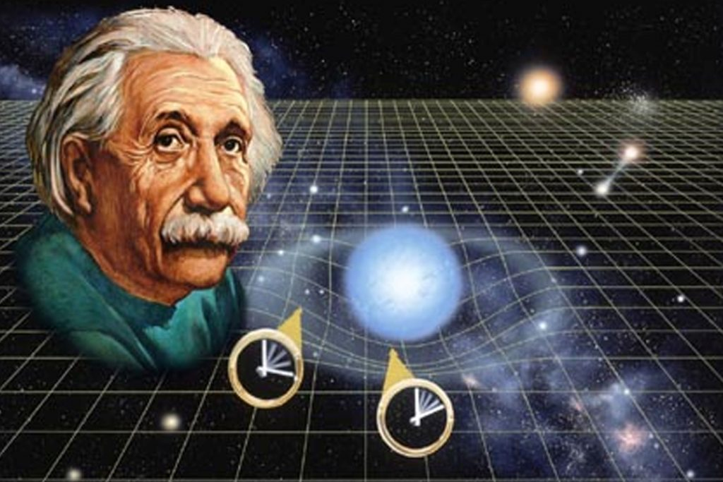
Theoretical knowledge: hypothesis, prediction, theory, meta-theory, beyond and between them.
Made by
Second-year student of IASA
Oleksii Kosiuk

Slide 2
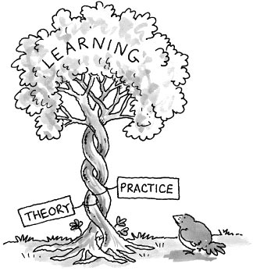
Theoretical knowledge
Theoretical knowledge - general and necessary characteristics of objects. Represents a system of abstractions, capable of disclosing its subject content in categorical definitions, regular connections, cause-and-effect schemes. It is focused on a detailed explanation of phenomena, analysis of their "mechanisms" and deep foundations. In contrast to empirical knowledge, is the sphere of the formulation of general concepts, hypothetical assumptions, idealizing constructions, the implementation of "thinkable" experiments and predictions.

Slide 3
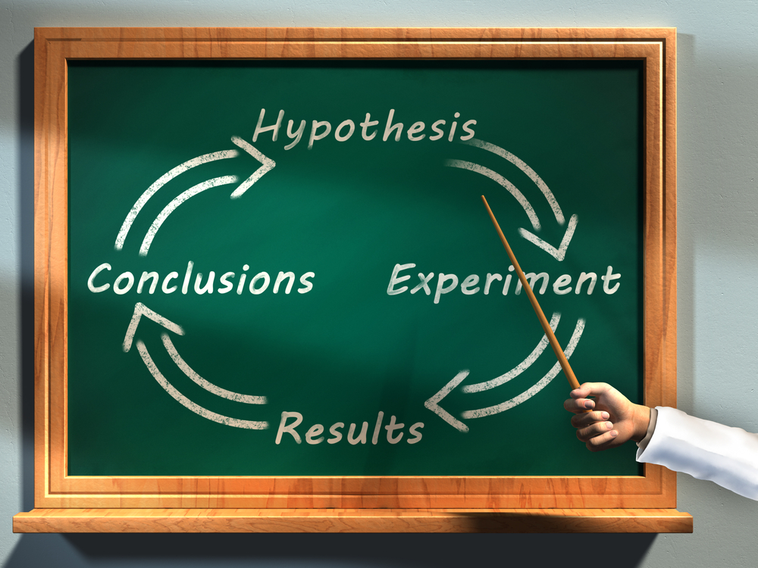
Hypothesis
A hypothesis (plural hypotheses) is a proposed explanation for a phenomenon. For a hypothesis to be a scientific hypothesis, the scientific method requires that one can test it. Scientists generally base scientific hypotheses on previous observations that cannot satisfactorily be explained with the available scientific theories. Even though the words "hypothesis" and "theory" are often used synonymously, a scientific hypothesis is not the same as a scientific theory. A working hypothesis is a provisionally accepted hypothesis proposed for further research, in a process beginning with an educated guess or thought.

Slide 4

Prediction
A prediction (Latin præ-, "before," and dicere, "to say"), or forecast, is a statement about a future event. They are often, but not always, based upon experience or knowledge. There is no universal agreement about the exact difference from "estimation"; different authors and disciplines ascribe different connotations.
Although future events are necessarily uncertain, so guaranteed accurate information about the future is impossible. Prediction can be useful to assist in making plans about possible developments; Howard H. Stevenson writes that prediction in business "is at least two things: Important and hard."

Slide 5
Difference between hypothesis and prediction
Comparison parameter | Hypothesis | Prediction
Meaning | A hypothesis implies a suggested factual explanation of an observed event as an introduction to further investigation. | Prediction refers to a statement that says or evaluates something that will happen in the future.
What is it? | A tentative guess that can be tested scientifically. | Pre-announcement of what should happen next in the sequence of events.
Guess | Educated guess | Clear guess
Based on | Facts and Evidence. | May or may not be based on facts or evidence.
Explanation | Yes | No

Slide 6

Meta-theory
A metatheory or meta-theory is a theory whose subject matter is itself a theory. In mathematics and mathematical logic, a metatheory is a mathematical theory about another mathematical theory. Meta-theoretical investigations are part of the philosophy of science. A metatheory is not applied directly to practice, but may have applications to the practice of the field it studies. The emerging field of metascience seeks to use scientific knowledge to improve the practice of science itself.

Slide 7
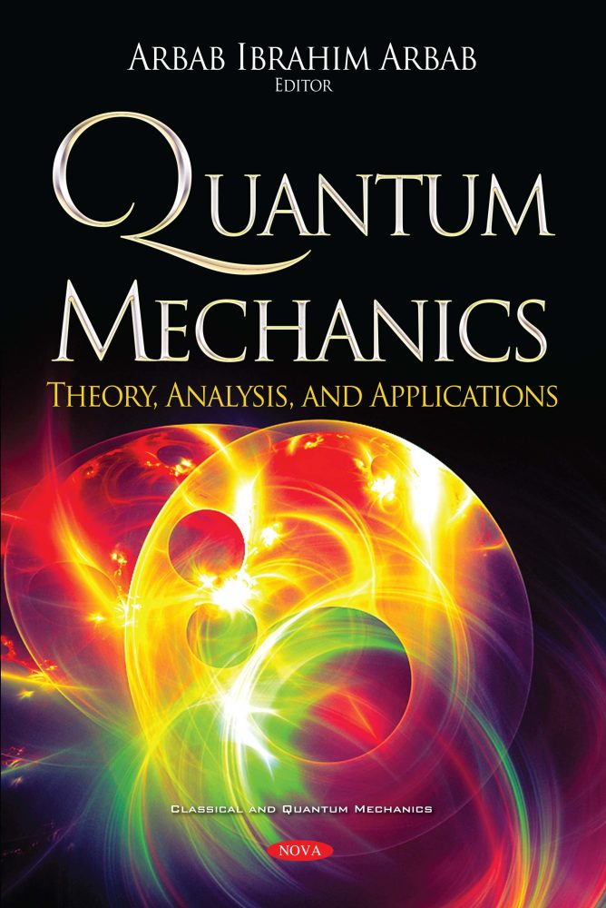
Theory
A theory is a rational type of abstract thinking about a phenomenon, or the results of such thinking. The process of contemplative and rational thinking often is associated with such processes like observational study, research. Theories may either be scientific or other than scientific (or scientific to less extent). Depending on the context, the results might, for example, include generalized explanations of how nature works. The word has its roots in ancient Greek, but in modern use it has taken on several related meanings.
In modern science, the term "theory" refers to scientific theories, a well-confirmed type of explanation of nature, made in a way consistent with scientific method, and fulfilling the criteria required by modern science.

Slide 8
Difference between theory and meta-theory
The main difference between theory and metatheory is an object or concept on which each is based:
Theory is based in observations and its main assignment is to explain some natural phenomenon via using observations and making hypothesis.
Metatheory is based on another theory and therefore can’t have direct relation to natural phenomenons, results of experiments, observations e. c. It only has relation to educated theory and its main aim is to improve methods of creating some particular applied theory based on real facts.

